Slide 1

#LifeKoKaroLift
PCA and Clustering: Pre-Assignment Session

Slide 2


Course : Data Science
Lecture On : Pre-Assignment
Instructor : Sumit Shukla

Slide 3
What we will cover in this session?
1
Demo using sample data
2
Assignment discussion
3
Points to remember.
4
Quiz

Slide 4

#LifeKoKaroLift
Let’s Code

Slide 5
PCA and Clustering Assignment
Coding Questions
Use this link to download the questions notebook: https://drive.google.com/file/d/1sR23P6bhk5eZam7IEN0Xzku1xWJ9KrjB/view?usp=sharing
Question-1: Is there any null in the data?
YES
NO
Question-2: Which column have some outliers?
sepal_lenght
sepal_width
petal_lenght
Question-3: What is the maximum value in the scaled array we have?
3.1
5.1
2.8

Slide 6
PCA and Clustering Assignment
Coding Questions
Question-4: Which variable explains the maximum variance in the original data?
sepal_lenght
petal_lenght
petal_width
Question-5: What is the first component of the first vector obtained from pca.components_?
0.55
0.45
0.53
Question-6: What is the variance explained by the first principal component?
70%
80%
90%

Slide 7
PCA and Clustering Assignment
Coding Questions
Question-7: What is the number of PCs we can go about?
2
3
4
Question-8: Is the given data good for performing Clustering?
YES
NO

Slide 8
PCA and Clustering Assignment
Coding Questions
Question-9: Look at the silhouette score plot and choose the optimal number of cluster
2
3
4
Question-10: Look at the Elbow Curve plot and choose the optimal number of cluster
2
3
4

Slide 9

#LifeKoKaroLift
Assignment Explanation

Slide 10
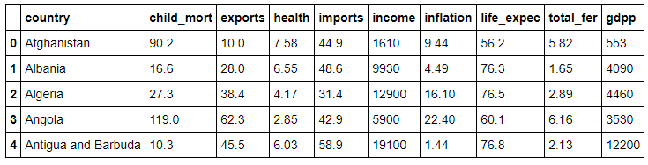
PCA and Clustering Assignment
Step to procedure in the Assignment
Let’s first understand the problem statement:
Identify top countries that are direst need of aid. Your job is to categorise the countries using some socio-economic and health factors that determine the overall development of the country. Then you need to suggest the countries which the CEO needs to focus on the most.

Slide 11
PCA and Clustering Assignment
Step to procedure in the Assignment
Data Understanding.
Hint: Don’t forget to read the data description properly.
Perform PCA.
Data Standardisation
Perform PCA and choose the PCs that defines more than 85% variance.
Run the PCA with the chosen number.
Perform Clustering.
Data preparation for clustering.
Outlier treatment
Hopkins check
Clustering
K-MEANS
Run K-Means and choose K using both Elbow and Silhouette score
Run K-Means with the chosen K
Visualise the clusters
Clustering profiling.

Slide 12
PCA and Clustering Assignment
Step to procedure in the Assignment
Perform Clustering.
Clustering
Hierarchical Clustering
Use both Single and Complete linkage
Choose one method based on the results
Visualise the clusters
Clustering profiling.
Country Identification
Based on the analysis, choose the countries that are in need for the aid.
Choose the countries based on some socio-economic and health factors.

Slide 13
What to keep in mind
You need to comment your code properly.
You need to submit 3 files zipped as one file. A python notebook with all the code, A PPT(Converted as PDF) with all the recommendation and A PDF with part-II of the assignment.
PPT is for managers, so don’t add unnecessary pages. PPT should cover main points from your analysis.
Choose PCs and K wisely as this reflects the final solution.
Mention your assumptions in your notebook, If taken any.
For any help regarding assignment, use Discussion Forum.
For any help regarding coding error, use online portals such as StackOverflow.

Slide 14


#LifeKoKaroLift

Slide 15
Interactive Questions
In the following questions we will try to implement Hierarchical Clustering from scratch.
Person | X | Y
A | 2 | 4
B | 8 | 2
C | 9 | 3
D | 1 | 5
E | 8.5 | 1

Slide 16
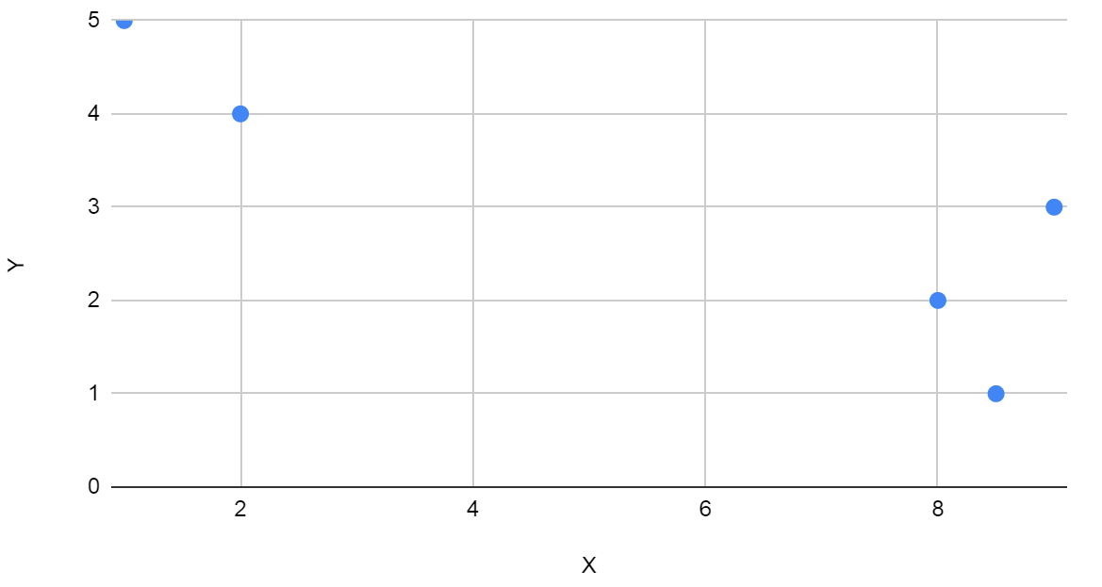
Interactive Questions
Let’s visualise the data:

Slide 17
Interactive Questions
Let’s start with forming distance matrix: Step-1:
 | A | B | C | D | E
A | 0 | 6.325 | 7.071 | 1.414 | 7.159
B |  | 0 | 1.414 | $ | 1.117
C |  |  | 0 | 8.246 | 2.062
D |  |  |  | 0 | #
E |  |  |  |  | 0

Slide 18
Interactive Questions
Question-1: Find the distance between D and B, Fill the block $
1.414
2.95
7.616
Question-2: Find the distance between E and D, Fill the block #
2.11
9.99
8.50

Slide 19
Interactive Questions
Let’s start with forming distance matrix: Step-2:
 | A | B | C | D | E
A | 0 | 6.325 | 7.071 | 1.414 | 7.159
B |  | 0 | 1.414 | 7.616 | 1.117
C |  |  | 0 | 8.246 | 2.062
D |  |  |  | 0 | 8.500
E |  |  |  |  | 0

Slide 20
Interactive Questions
Let’s start clustering them by finding minimum distance between two points
 | A | B | C | D | E
A | 0 | 6.325 | 7.071 | 1.414 | 7.159
B |  | 0 | 1.414 | 7.616 | 1.117
C |  |  | 0 | 8.246 | 2.062
D |  |  |  | 0 | 8.500
E |  |  |  |  | 0

Slide 21
Interactive Questions
Question-3: What will be the first cluster formed?
DB
BE
DA

Slide 22
Interactive Questions
Let’s reduce the distance matrix with the new cluster
Question-4: Find the value of ? in the given matrix
1.414
7.071
2.062
 | BE | A | C | D
BE | 0 | 6.325 | ? | 7.614
A |  | 0 | 7.071 | 1.414
C |  |  | 0 | 8.246
D |  |  |  | 0

Slide 23
Interactive Questions
Let’s reduce the distance matrix with the new cluster
Let’s further reduce the matrix using the minimum distance
 | BE | A | C | D
BE | 0 | 6.325 | 1.414 | 7.614
A |  | 0 | 7.071 | 1.414
C |  |  | 0 | 8.246
D |  |  |  | 0

Slide 24
Interactive Questions
Let’s reduce the distance matrix with the new cluster
Question-5: What will be the value of ? in the following table
8.246
7.614
7.071
 | BE | AD | C
BE | 0 | 6.352 | 1.414
AD |  | 0 | ?
C |  |  | 0

Slide 25
Interactive Questions
Let’s reduce the distance matrix with the new cluster
Let’s further reduce the matrix using the minimum distance
 | BE | AD | C
BE | 0 | 6.352 | 1.414
AD |  | 0 | 7.071
C |  |  | 0

Slide 26
Interactive Questions
Let’s reduce the distance matrix with the new cluster
Question-6: What will be the value of ? in the following table
7.071
6.352
1.414
 | BEC | AD
BEC | 0 | ?
AD |  | 0

Slide 27
Interactive Questions
Final Matrix
 | BEC | AD
BEC | 0 | 6.325
AD |  | 0

Slide 28
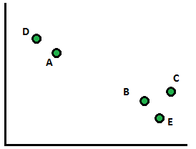
Interactive Questions
Let’s visualise the clusters based on the distance matrix
Circle the cluster as per the steps we performed previously.

Slide 29
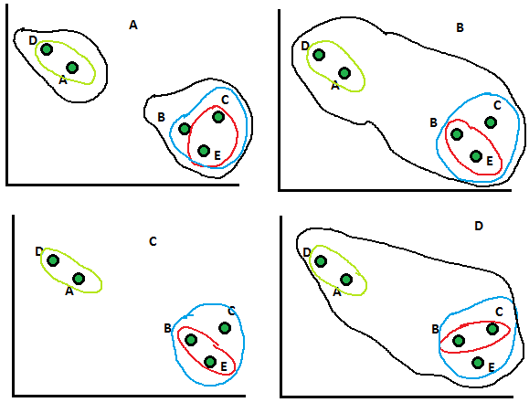
Interactive Questions
Question-7: Choose the correct cluster image:

Slide 30
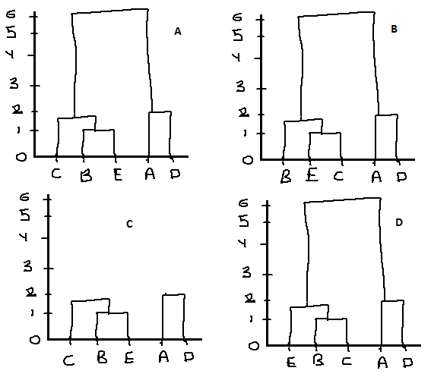
Interactive Questions
Question-8: Choose the correct Dendrogram

Slide 31
Interactive Questions
Question-9: PCA can be used for projecting and visualizing data in lower dimensions
True
False
Question-10: What is the necessary condition hold true in case of Principal Components?
They needed to be in same direction
They needed to be orthogonal to each other
They should not be in the direction of maximum variance

Slide 32
#LifeKoKaroLift
Thank You!

